Slide 1
#StopTheBias: Fact or Fiction?
Presenter: Matthew Stevenson
CS895 – February 26, 2019
Original Source: https://twitter.com/realDonaldTrump/status/1034907478566359041

Slide 2
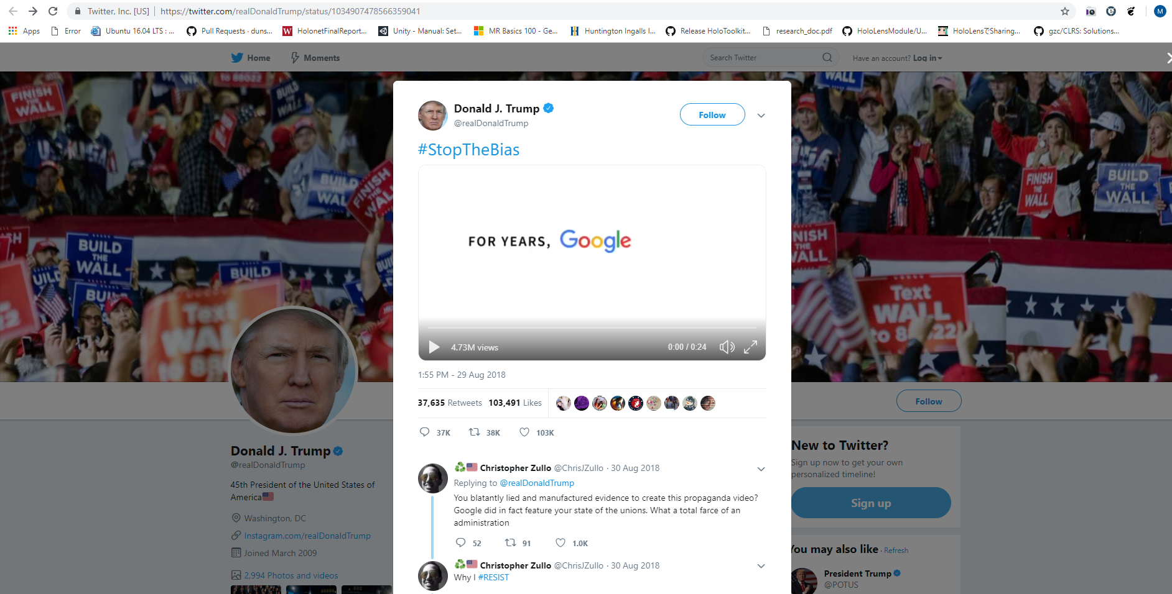
Source: https://twitter.com/realDonaldTrump/status/1034907478566359041

Slide 3
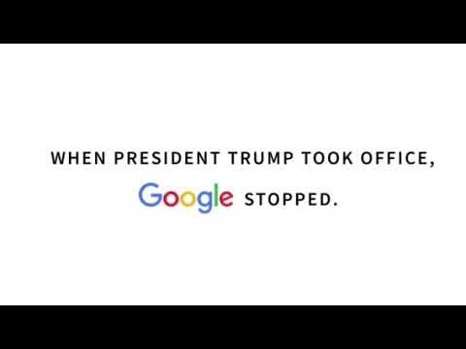
Source: https://www.youtube.com/watch?v=GzxMj9sGMbE

Slide 4
So what was the response?
Let Us take a look.

Slide 5
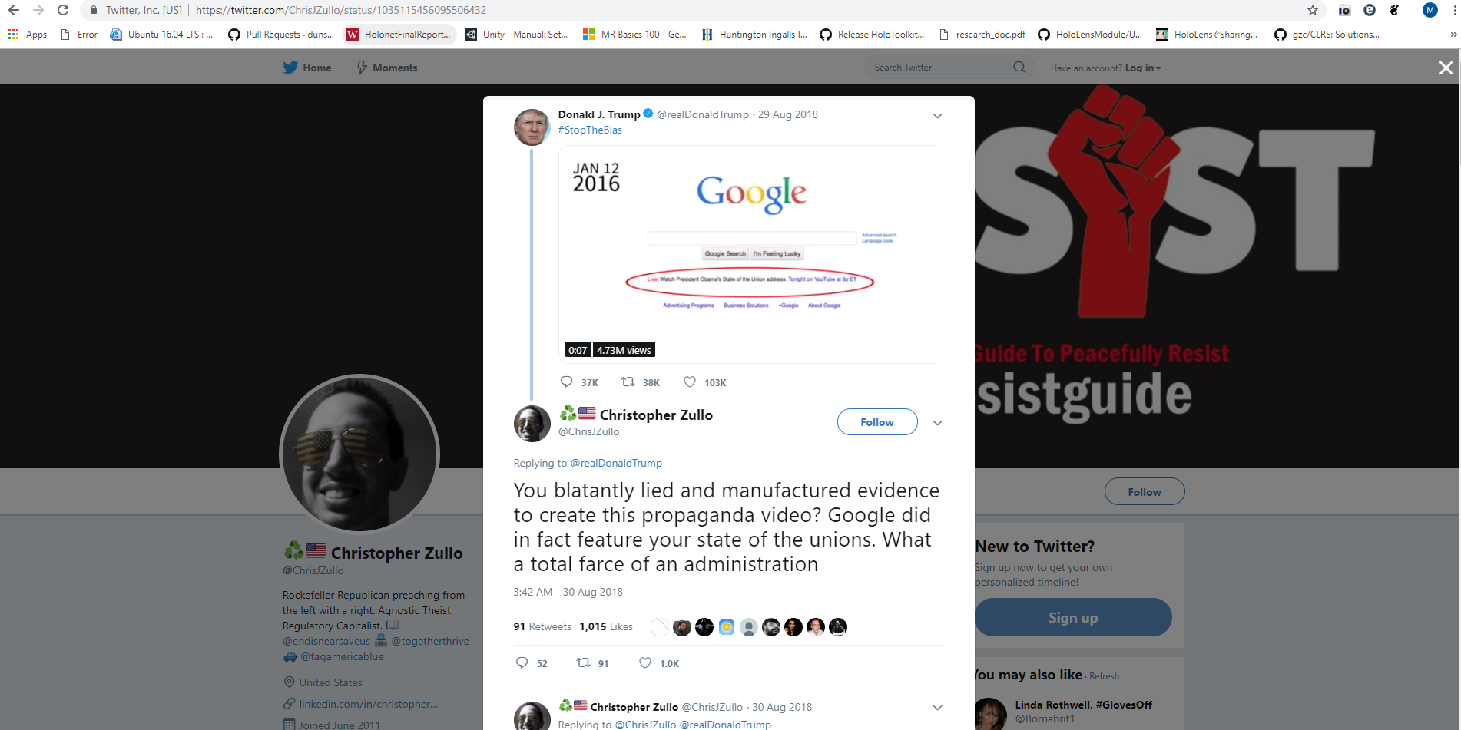
Source: https://twitter.com/ChrisJZullo/status/1035115456095506432

Slide 6
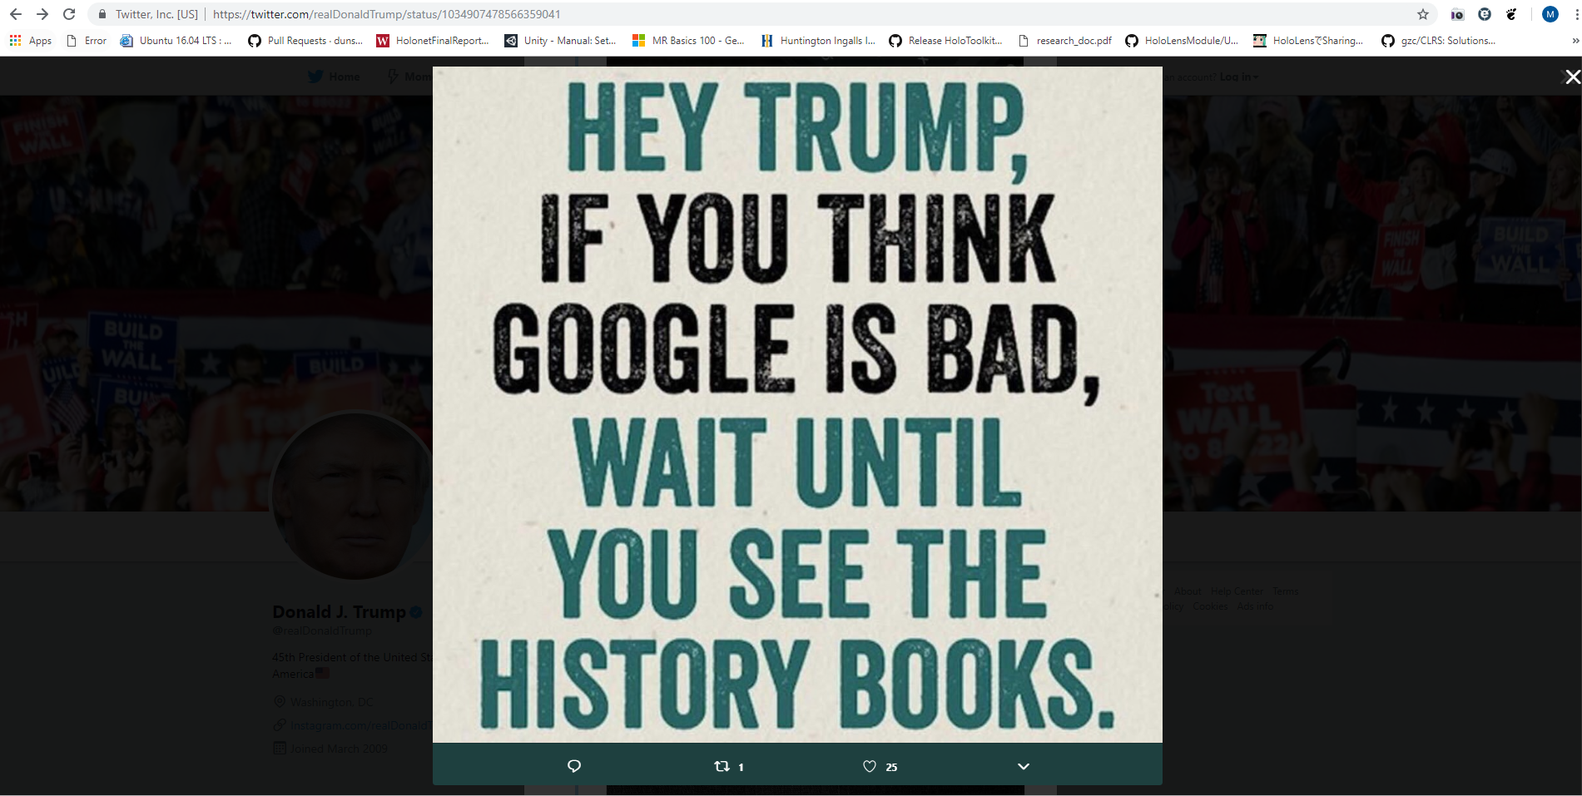
Source: https://twitter.com/realDonaldTrump/status/1034907478566359041

Slide 7
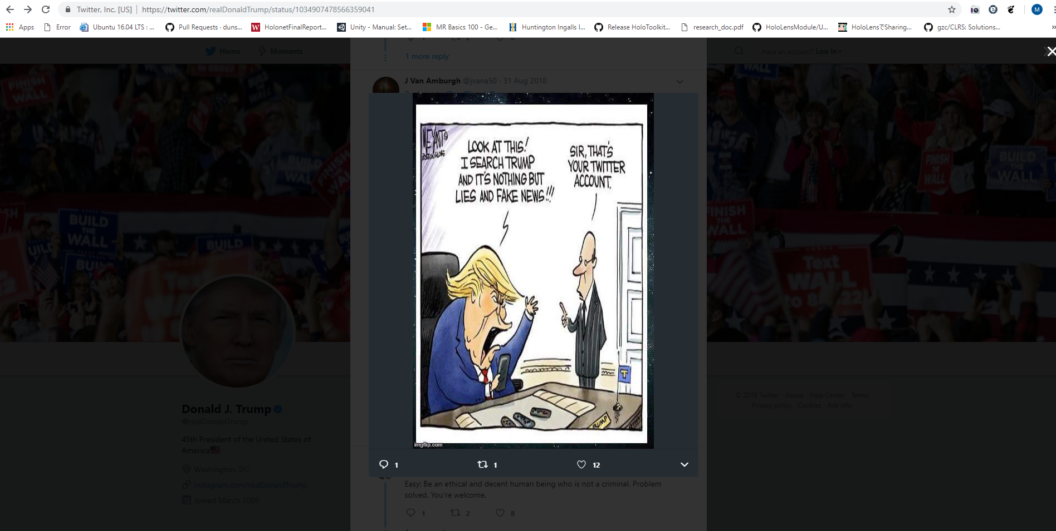
Source: https://twitter.com/realDonaldTrump/status/1034907478566359041

Slide 8
Are these accusations based on fact or fiction?
Let’s Take A look at the evidence.

Slide 9
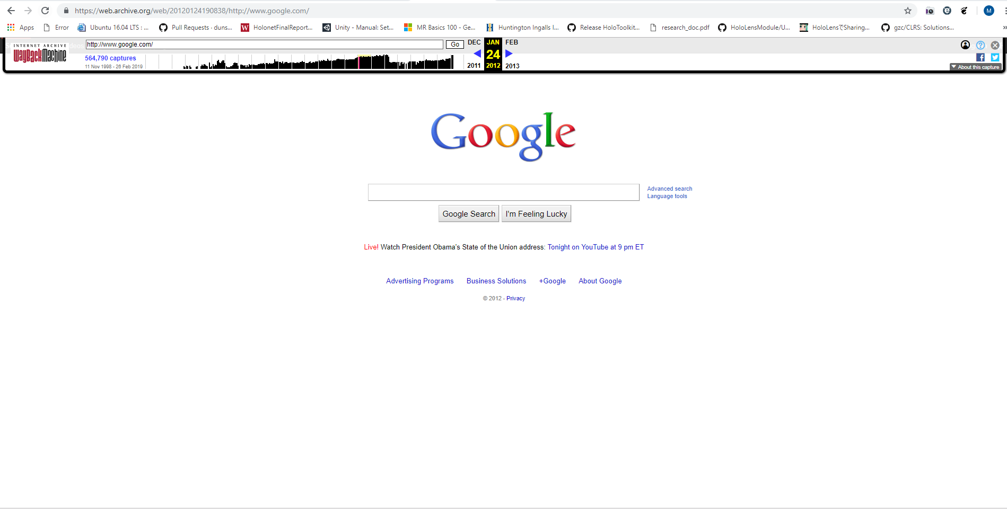

January 24th, 2012
State of the Union - Obama
Source: https://web.archive.org/web/20120124190838/http://www.google.com/

Slide 10

February 12th, 2013
State of the Union - Obama
Source: https://web.archive.org/web/20130212210553/http://www.google.com/

Slide 11
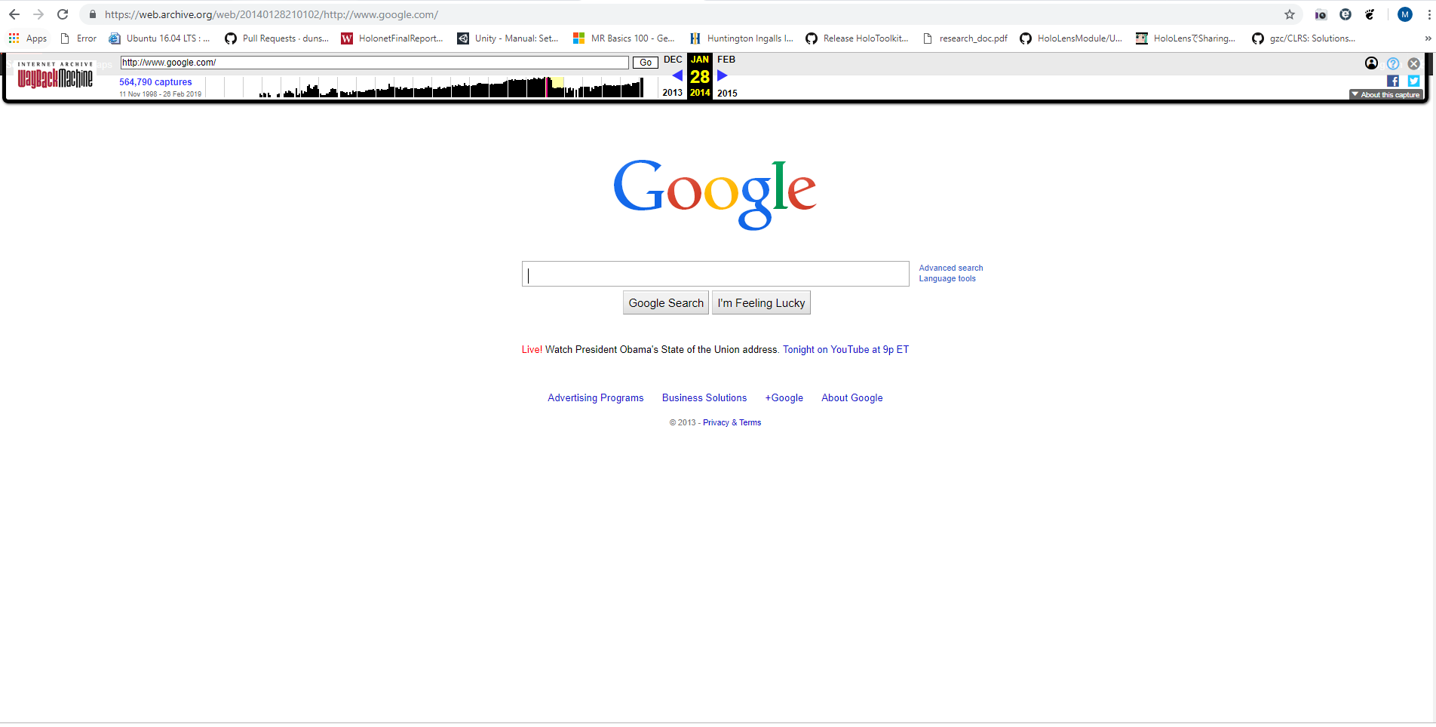
January 28th, 2014
State of the Union - Obama
Source: https://web.archive.org/web/20140128210102/http://www.google.com/

Slide 12
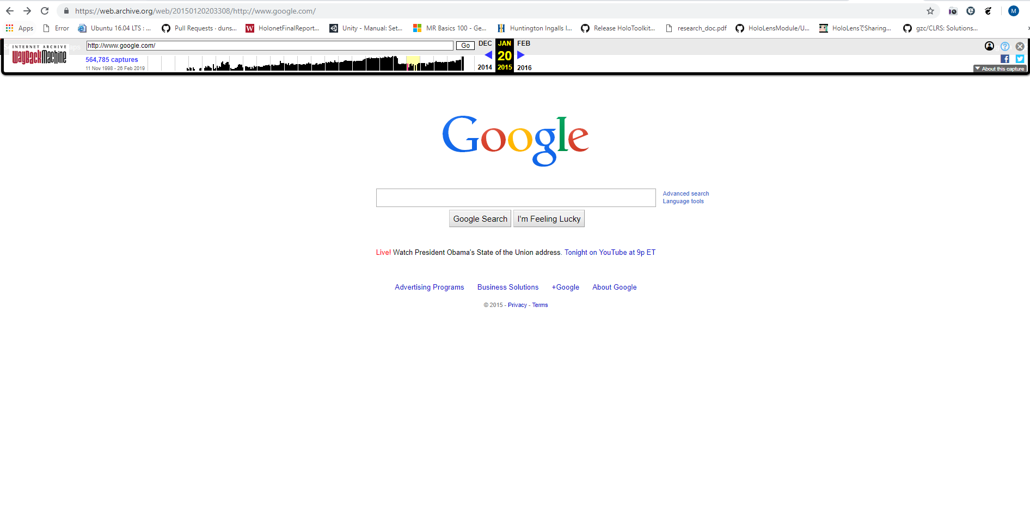
January 20th, 2015
State of the Union - Obama
Source: https://web.archive.org/web/20150120203308/http://www.google.com/

Slide 13
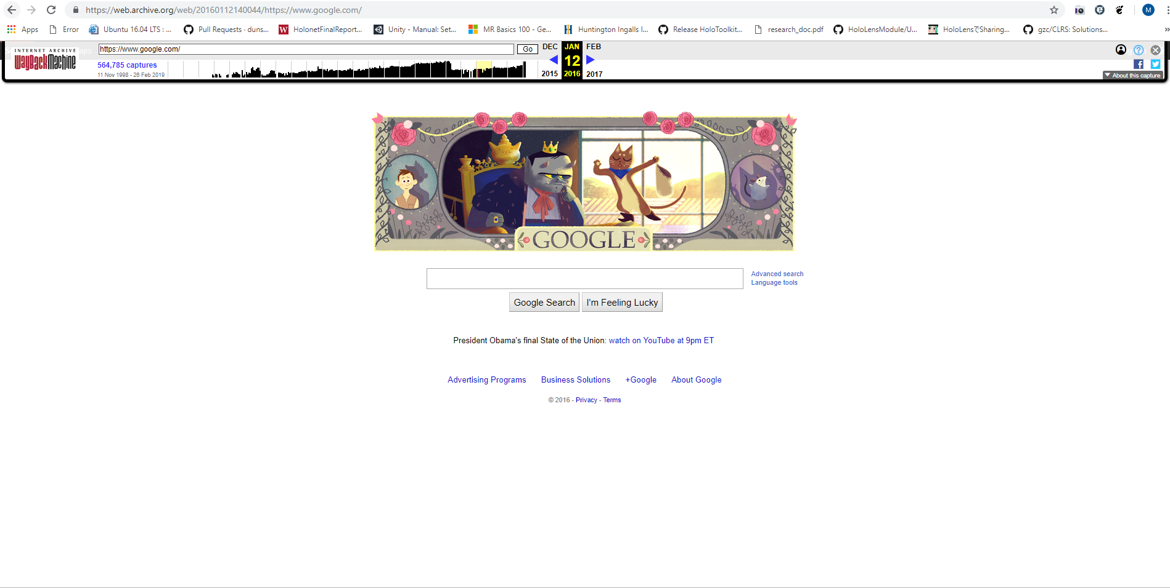
January 12th, 2016
State of the Union - Obama
Source: https://web.archive.org/web/20160112140044/https://www.google.com/

Slide 14
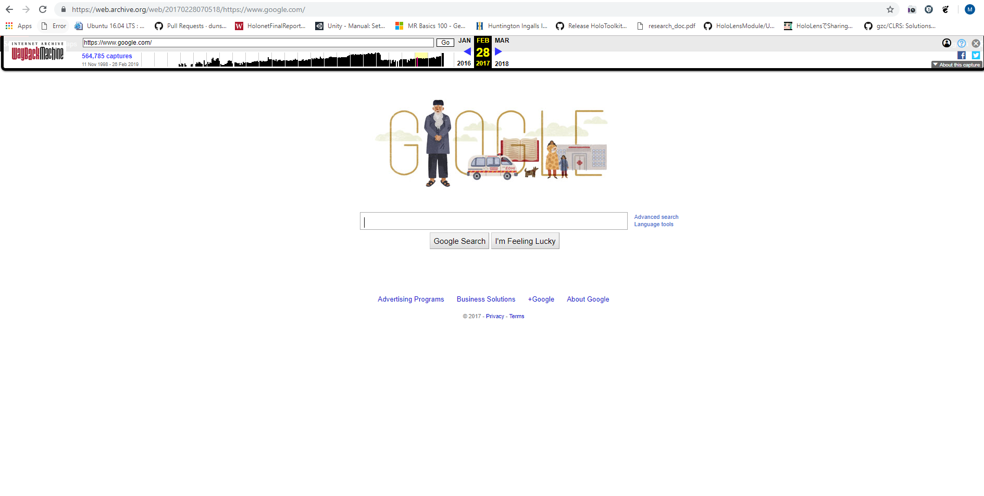
February 28th, 2017
State of the Union – Trump?
Source: https://web.archive.org/web/20170228070518/https://www.google.com/

Slide 15
So all the pages presented were corret…
But Why Did google not promote Trump?

Slide 16
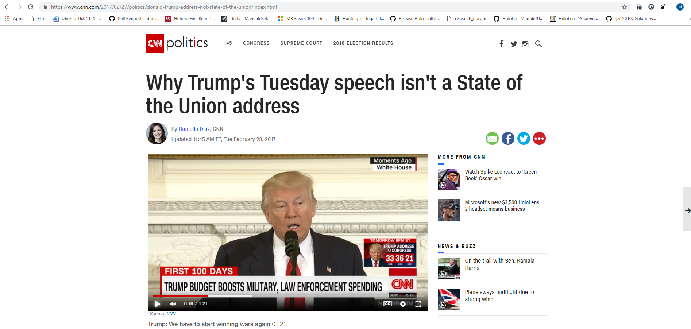
Source: https://www.cnn.com/2017/02/27/politics/donald-trump-address-not-state-of-the-union/index.html

Slide 17
Given this information
What about the Next Page?

Slide 18
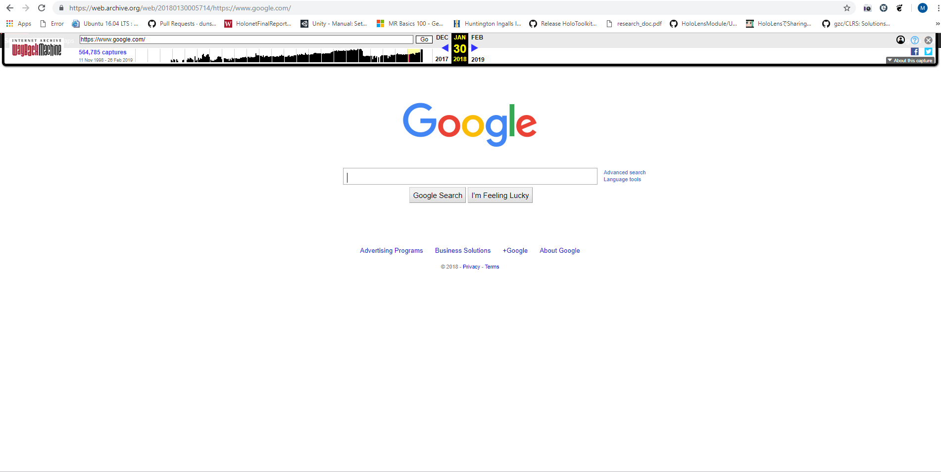
January 30th, 2018
State of the Union – Trump?
Source: https://web.archive.org/web/20180130005714/https://www.google.com/

Slide 19
So what is happening here?
Let’s find Out

Slide 20
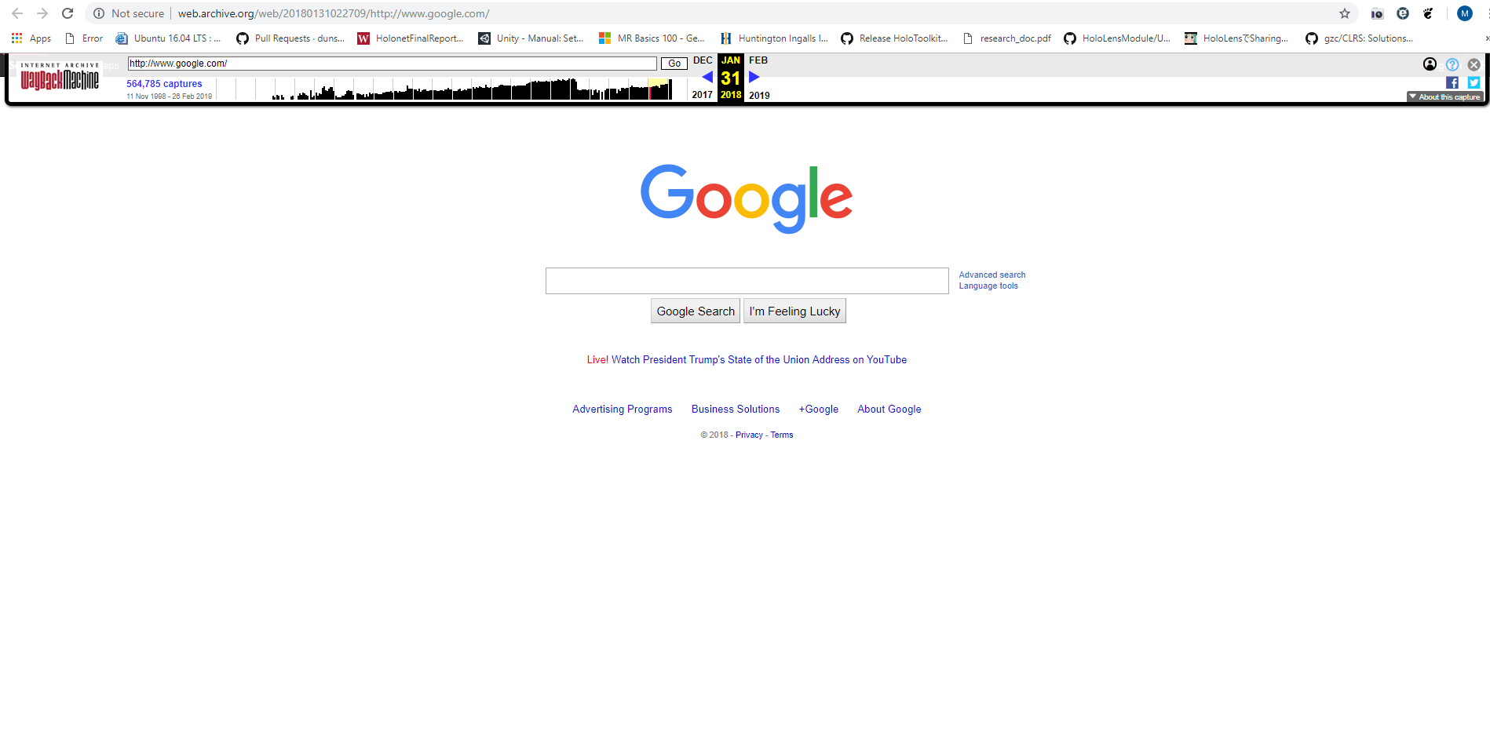
January 31st, 2018
State of the Union – Trump
Source: http://web.archive.org/web/20180131022709/http://www.google.com/

Slide 21
WayBack Machine’s Time Zone Mishaps
The creator of the video used the incorrect link due to being in a different time zone.

Slide 22
Now back to the video
Displays false information
Is an example where false information disrupts public opinion
Proves social media quickly unravels due to politics

Slide 23
Contact Information:
Twitter: @mstev0du
Github: https://github.com/mst3v3nsn
Google Groups: https://groups.google.com/forum/#!forum/cs895-s19

